Slide 1


SpotifyClassifier
ELEN E6893 Big Data Analytics
Presented December 17, 2021
1st Alex Thornton
Dept. of Electrical Eng.
Columbia University
New York, NY
apt2141@columbia.edu
2nd Elmira Aliyeva
Dept. of Computer Science
Columbia University
New York, NY
ae2970@columbia.edu
3rd Tanvi Pande
Dept. of Computer Science
Columbia University
New York, NY
tp2673@columbia.edu

Slide 2

Project Overview
Track Genre Classification
Used Spotify Dev API to create our own dataset
Predicts genre from name only!
No need for mp3 file of song to classify
Fig 1. Spotify - source for song metadata

Slide 3


Business Value
Users are curious about 'Spotify Wrapped' genre listening patterns
Spotify API only provides genre labels for artists, not tracks
Some artists have many genres
Pop
Country
Rock
Electro-pop
R&B
Rap
Example
You enjoy 'Ronin (Taylor's Version)'
What genre is it?
Taylor Swift has written pop, country, folk, rap, and more!
We provide labels for individual tracks!
Fig 2. Red (Taylor's Version)
vs. Reputation album comparison

Slide 4
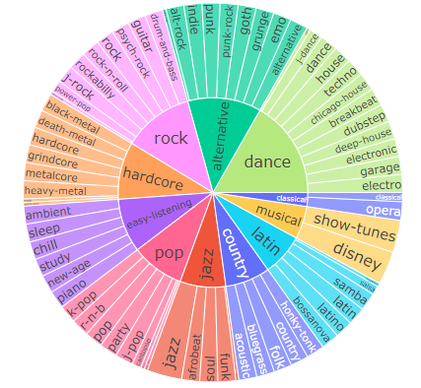
New Dataset
Queried Spotify for recommendations across 73 subgenres
~500 tracks labelled for each subgenre
Collected Spotify metadata for individual tracks, added subgenre labels
Grouped 73 subgenres ->11 'super-genres' for simpler classification
Fig 3. Our dataset hierarchy

Slide 5
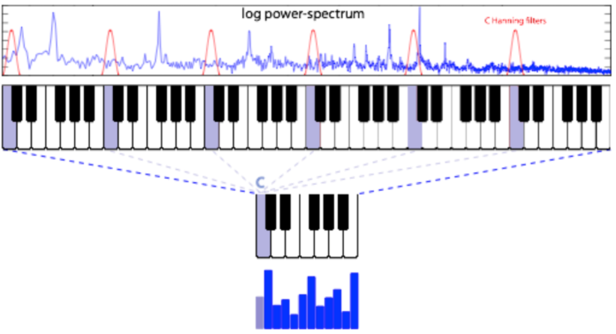
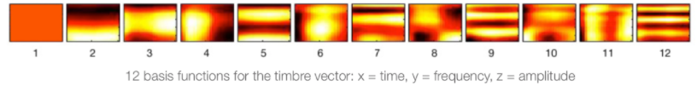
Feature Variety
Combined Spotify audio features and audio analysis
Averaged pitch and timbre vectors over all song segments
Included other miscellaneous metrics (popularity, date of release, explicit lyrics)
Fig 4. Pitch feature vector
Fig 5. Timbre feature vector

Slide 6
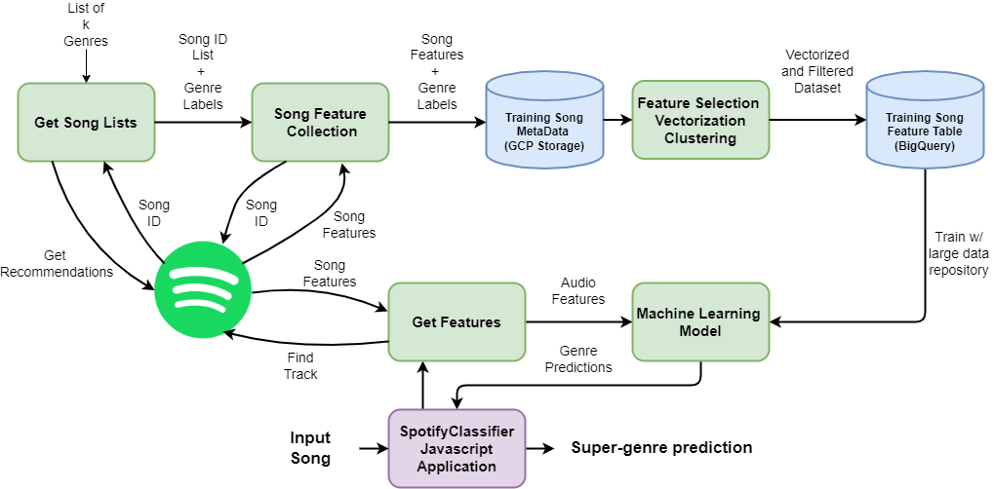
Model Architecture
Fig 6. System Diagram

Slide 7
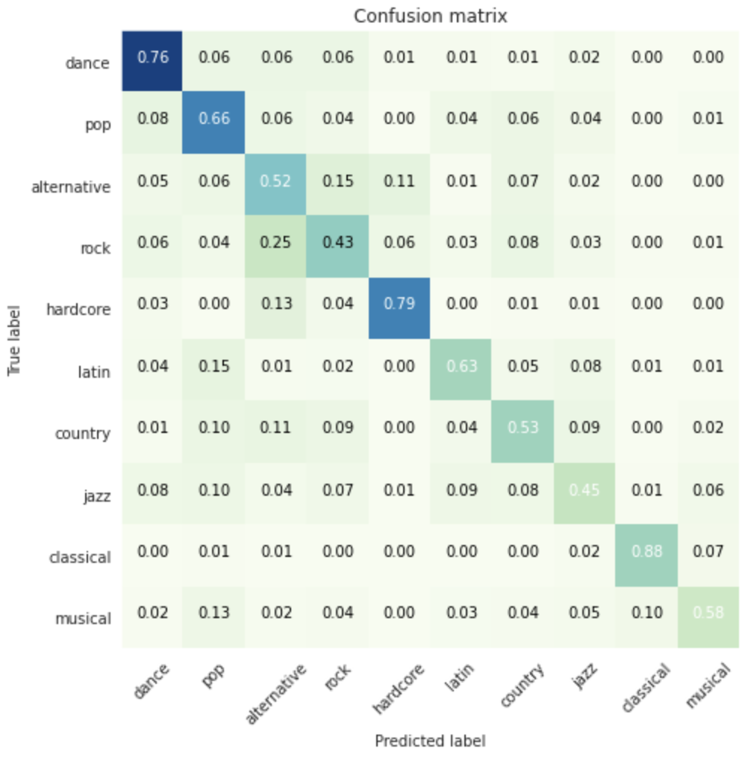
Model Performance
Tested models
Random Forest Classifier. Accuracy: 0.4765
Decision Tree Classifier. Accuracy: 0.4156
Logistic Regression. Accuracy: 0.5518
LinearSVC. Accuracy: 0.4796
GBT Classifier Accuracy: 0.6223
GBT results
Test set F1-Score: 0.6217
Test set Precision: 0.6238
Test set Recall: 0.6223
Test set Accuracy: 0.6223
As a benchmark, human accuracy averages around 70% for this kind of genre classification work [1].
[1] Mingwen Dong. Convolutional neural network achieves human-level accuracy in music genre classification. CoRR, abs/1802.09697, 2018.
Fig 7. Test Set Confusion Matrix

Slide 8
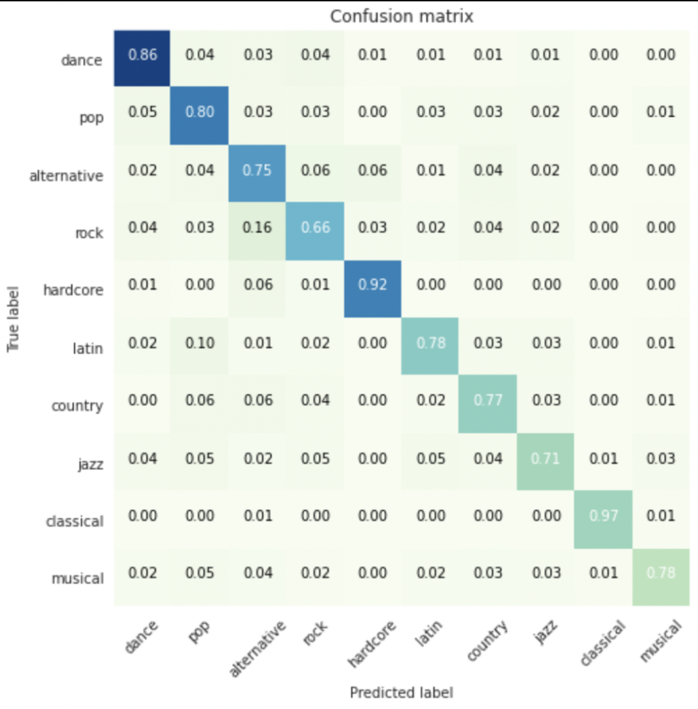
Model Performance
Fig 8. Train Set Confusion Matrix

Slide 9



Analysis: What is this, a crossover episode?
'12qZHAeOyTf93YAWvGDTat': ['alternative', 'emo', 'garage', 'grunge', 'guitar', 'party', 'punk-rock', 'rock-n-roll', 'study']
'1MUQ6LtYIw6sSGQJEoIi2X': ['acoustic', 'alternative', 'bluegrass', 'chill', 'folk', 'sleep', 'study']
'3FtYbEfBqAlGO46NUDQSAt': ['alternative', 'chill', 'indie-pop', 'party', 'study', 'techno']

Slide 10
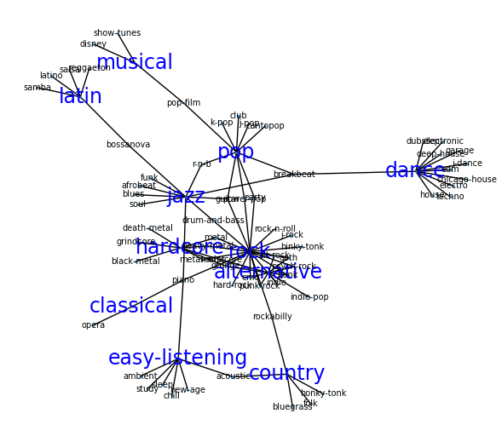
Super-Genres as a Graph
Maybe 'super-genre' hierarchy model was an oversimplification
Perhaps some subgenres belong to more than one cluster
Ex: "alt-rock" = "rock"&"alternative"
We set out to find more representative super-genres
Also want to identify problematic (highly interconnected) subgenres
Fig 9. Our expected underlying structure

Slide 11
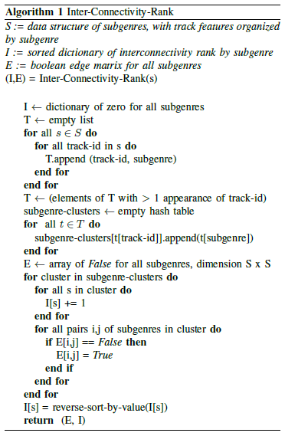
Inter-Connectivity-Rank
Find tracks that were recommended for multiple genres
Create graph with subgenres = nodes, subgenre-subgenre overlap = edges
Rank subgenres with highest number of 'collisions' (cross labelled tracks w/ other subgenres)
Think opposite of PageRank, less connections is better!

Slide 12
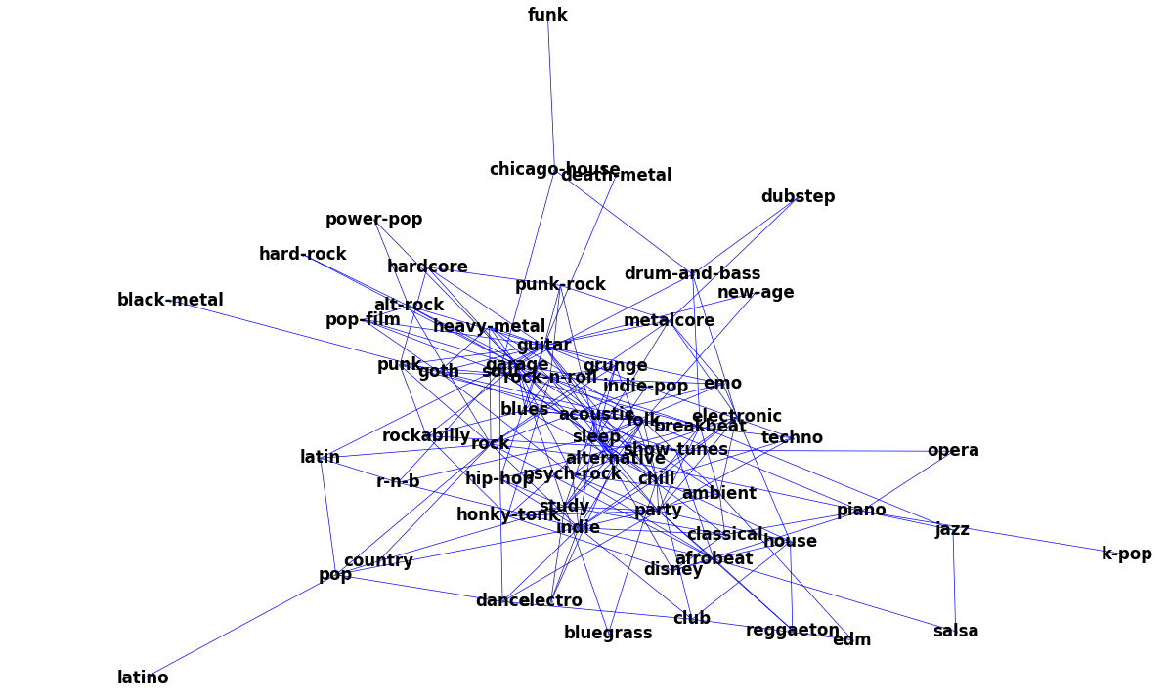
Inter-Connectivity Visualized
Not expecting 'sleep' to be so connected
Unsurprising 'blues' is central
Fig 10. True underlying structure

Slide 13
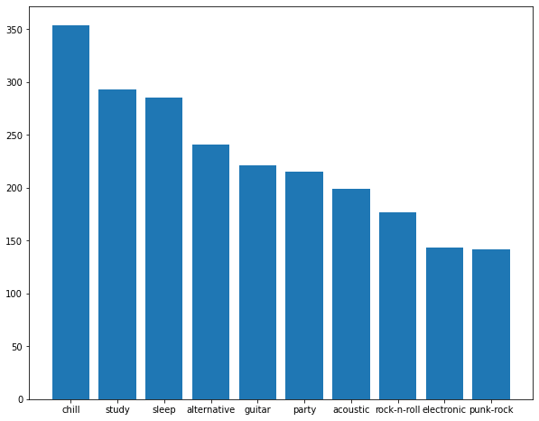
Top Inter-Connectivity-Ranked Subgenres
Ranked based on subgenre overlap
'chill', 'study', and 'sleep', rounded out the top 3
Interestingly, these were all part of our 'easy-listening' super-genre
'guitar', 'party, and 'acoustic' are unsurprising offenders, as they are vague
Fig 11. Top interconnected subgenres

Slide 14
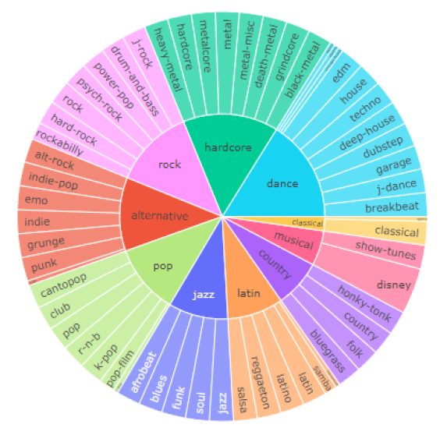
Actions from Findings
Tossed top 10 scoring subgenres from Inter-Connectivity-Rank
Improved model result to the findings previously shown
See updated Sunburst diagram for dataset without highly connected subgenres
Fig 11. Updated dataset hierarchy

Slide 15
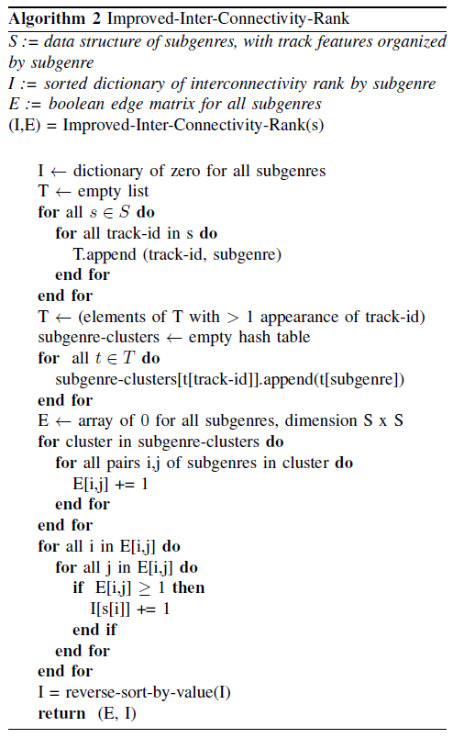
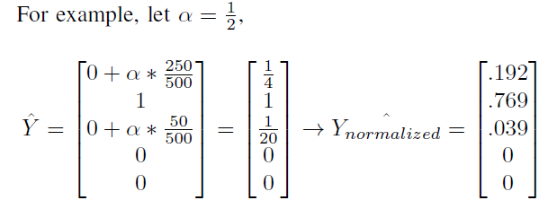
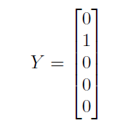
Improved Algorithm
Commonly mismatched subgenres like rock / alternative could artificially increase ranking
Seek 'better' ranking based on number of unique edges rather than number of collisions
Can use edge matrix to improve labels from one-hot encoding to account for genre overlap

Slide 16

Stretch Goals
Didn't quite get this perfect for today
Connect front end of website to back end
Display album art / animation of input track
Visualize prediction scores against our sunburst and graph clustering visuals
Fig 12. Website Front End

Slide 17

Check us out on github!
https://github.com/athornton1618/SpotifyClassifier

